Slide 1




Welcome to Medicare
presented by the
Area Agency on Aging of Dane County
Elder Benefit Specialist Program
November 15, 2025
Adapted from CMS, Medicare Rights Center, SHIP, OCI, EBS, and GWAAR materials
This project was supported by the Wisconsin Department of Health Services with financial assistance, in whole or in part, by grant number 90SAPG0091, from the U.S. Administration for Community Living, Department of Health and Human Services, Washington, D.C. 20201. Grantees undertaking projects with government sponsorship are encouraged to express freely their findings and conclusions. Points of view or opinions do not, therefore, necessarily represent official ACL policy
Notes:
Good Morning. This Welcome to Medicare program will provide an overview of Medicare.

Slide 2



Slide 3

Presentation Outline
Medicare Basics
Coverage Choices
Medicare Enrollment
Medicare Basics of A, B, C, and D
Medicare Advantage vs. Supplement
Medicare and the Marketplace
Help for People with Limited Income
Resources
Find more detailed information in the Medicare & You Handbook.
Notes:
During this presentation, we will review:
Medicare Basics
Enrollment in Medicare
Your Coverage Choices
Senior Care
Help for People with Limited Income
Resources
—Please refer to Medicare and You Handbook for further details. The Medicare & You handbook pictured on the slide is mailed to every Medicare household each year in the fall. It’s sent to all newly enrolled people as well. It explains Medicare and provides information on Medicare health and drug plans in their geographic area.

Slide 4

Housekeeping
General questions about slides are okay! Save personalized questions until the end, please. I will stay to answer as much as I can.
Keep in mind this is created for a wide range of understandings and levels of preparedness, and includes basics AND some complex ideas.
There will be a 5-10 minute break in the middle. Take any breaks as needed though.
Notes:
Medicare currently provides health insurance coverage for 54 million U.S. citizens. That’s approximately 1 in every 6 Americans.

Slide 5
Medicare Basics - What is Medicare?
A national social health insurance program under Title XVIII of the Social Security Act, enacted in 1965, for lawfully present residents of the United States:
65 and older, or
Under 65 with certain disabilities who have received SSA benefits for 24 months beyond the initial 5 month waiting period, or
Any age with End-Stage Renal Disease (ESRD) or Lou Gehrig’s Disease (ALS)
Notes:
Medicare currently provides health insurance coverage for 54 million U.S. citizens. That’s approximately 1 in every 6 Americans.

Slide 6


Medicare Basics - Who runs Medicare?
Social Security Administration (SSA)
Establishes eligibility, enrolls most
individuals & collects premium
payments
Centers for Medicare & Medicaid Services (CMS)
Administers insurance program benefits
Railroad Retirement Board (RRB)
Enrolls railroad retirees

Slide 7
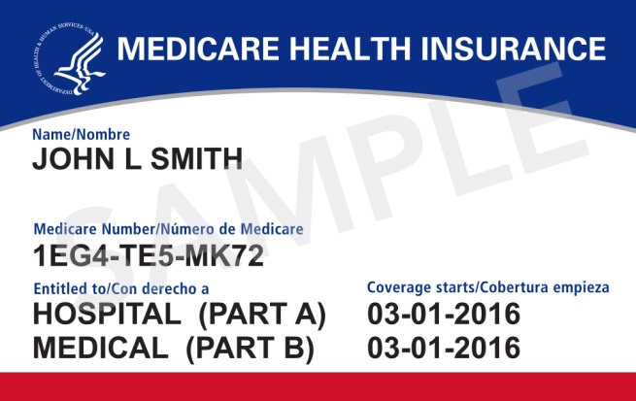
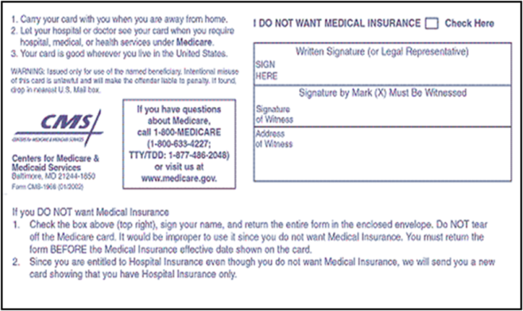
Medicare Basics - Medicare Card
Keep it to accept Medicare Part A and Part B; or
Return it to refuse Part B; follow instructions on back of card
What the Medicare card looks like:

Slide 8

Check Your Knowledge – Question #1
Who were the first two beneficiaries of Medicare and first to receive the Medicare cards?
a. George and Martha Washington
b. Harry and Elizabeth Truman
c. Ronald and Nancy Reagan
Notes:
Answer: Harry and Elizabeth “Bess” Truman

Slide 9
Your Medicare Coverage Choices

Slide 10




Original Medicare
Original Medicare is Part A (Hospital Insurance) and/or Part B (Medical Insurance) only
Medicare/CMS provides the coverage directly
You choose doctors, hospitals, and other providers that are accepting new Medicare patients
Costs are affected by whether or not providers accept assignment, which is an agreement by your provider to be paid directly by Medicare, accept the payment amount Medicare approves, and not bill you for any more than the Medicare deductible and coinsurance
Part A
Hospital Insurance
Part B
Medical Insurance
You can add…
Medicare Supplement (Medigap) Insurance
Medicare Part D prescription drug plan
Other creditable coverage
Notes:
Original Medicare includes Part A (Hospital Insurance) and/or Part B (Medical Insurance).
You can choose to buy a Medigap policy (you must have both Part A and Part B) to help cover some costs not covered by Original Medicare.
You can also choose to buy Medicare prescription drug coverage (Part D) from a Medicare Prescription Drug Plan (PDP). To buy a PDP you can have Part A only, Part B only, or both.
You can go to any doctor, other health care provider, hospital, or other facility that's enrolled in Medicare and is accepting new Medicare patients. Costs are affected by whether or not they accept assignment, which is an agreement by your doctor, provider, or supplier to be paid directly by Medicare, to accept the payment amount Medicare approves for the service, and not to bill you for any more than the Medicare deductible and coinsurance.

Slide 11

Original Medicare
Original Medicare does not cover:
Most dental care or dentures
Cosmetic surgery
Health care while traveling outside U.S.
Hearing aids and/or exams for fitting hearing aids
Long-term care
Most routine foot care & most supportive devices for feet
Routine eye care and most eyeglasses
Routine “physicals”
Notes:
Original Medicare does not cover these services. If you need these services, you will have to pay for them yourself unless
You have other coverage (including Medicaid) to cover the costs.
You’re in a Medicare Advantage Plan (Part C) that covers these services.
NOTE: as of 2021, Part B provides coverage of acupuncture for chronic low back pain.

Slide 12

Check Your Knowledge – Question #2
Whether you are enrolled in Original Medicare or a Medicare Advantage plan, you can see any doctor you want and have coverage:
a. True
b. False
Notes:
b. False

Slide 13
Medicare Enrollment
If you already receive benefits from Social Security or Railroad Retirement, you are automatically enrolled in Part A & B the first day of the month you turn 65.
If you are close to 65 and currently don’t receive Social Security benefits, you need to enroll in Part A & B with Social Security during your Initial Enrollment Period. (Next Slide)
Visit www.ssa.gov; or
Call Social Security at 1-800-772-1213 (National) or 1-866-770-2262 (Local field office in Madison; available Mon-Fri from 9am-4pm)
If you are under 65 and disabled, you are automatically enrolled in Medicare after receiving 24 consecutive months of SSDI, with 5 month waiting period.
November 15, 2025 Welcome to Medicare Presentation
Notes:
The first thing you will want to know about is how and when to enroll in Medicare.
If you already get benefits from Social Security or Railroad Retirement, you are automatically enrolled in Part A & B the first day of the month you turn 65.
If you are close to 65 and currently don’t receive Social Security benefits, you need to enroll in Part A & B with Social Security during your Initial Enrollment Period. (Next Slide.)
Visit socialsecurity.gov or
Call Social Security at 1-800-772-1213
Or for the local office: <contact info here>
If you are under 65 and disabled, you are automatically enrolled in Medicare after receiving 24 consecutive months of SSDI.
If you sign up for MyMedicare.gov, you can use it to manage personal information about Original Medicare benefits. It is a free, secure site that allows you to easily check information online about your coverage, enrollment status, and Medicare claims.

Slide 14
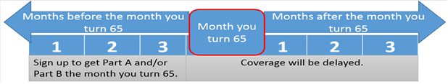
Initial Enrollment Period (IEP)
Coverage is effective the first day of the month following the month enrollment is requested.
7-month period includes 3 months before, month of, and 3 months after your 65th birthday
If you were born on 1st day of the month, the 7-month window begins the month before your birthday. Example: If birthday is June 1, the IEP window is Feb – Aug.
The month you request your enrollment will dictate the effective date of your coverage (see chart above).
Premium-free Medicare Part A can be back-dated up to 6 months, but not Part B.
Notes:
If you aren’t automatically enrolled, Your first opportunity to enroll in Medicare is during your Initial Enrollment Period (IEP), which lasts 7 months. Your coverage starts based on when you enroll. If you enroll during the first 3 months of your IEP (the 3 months before the month you turn 65), your coverage will begin the first day of the month you turn 65.
If you enroll in Part A and/or Part B
The month you turn 65, your coverage starts one month after you sign up.
One month after you turn 65, your coverage starts 2 months after you sign up.
2 months after you turn 65, your coverage starts 3 months after you sign up.
3 months after you turn 65, your coverage starts 3 months after you sign up.
During the January 1-March 31 General Enrollment Period, your coverage starts on July 1.
There is also a Special Enrollment Period:
Special Enrollment Period
If you wait to enroll in Part B because you or your spouse are still working and have group health plan coverage, you can sign up during the 8 months following the month the group plan coverage ends OR employment ends (whichever is first). There will be no penalty.
General Enrollment Period
January 1 through March 31. (For those who did not sign up during initial enrollment.) Penalty: Cost of Part B premium will go up 10% for each full 12-month period you delay enrolling. Coverage begins July 1.
The main point to remember is that if you are not receiving early retirement benefits, you should plan to enroll with Social Security about 3 months before you turn 65.

Slide 15

Special Enrollment Period (SEP) - Employment
You can chose to delay enrollment in Medicare if:
You or your spouse are currently working, and
You are covered under an employer group health plan (EGHP) based on active/current employment, and
The employer has more than 20 employees. (If less than 20 employees you should take Medicare at age 65, even if you are still working, because Medicare pays first.)
Notes:
Many people continue to work after they turn 65, so it is important to be clear about these points. Most people get Part A for free, so if still working, they enroll in Part A but delay Part B until they retire.
You can delay enrollment in Medicare if
You/your spouse are currently working and
Employer has more than 20 employees (if less than 20 employees you should take Medicare at age 65, even if you are still working.)
Enroll in Medicare anytime while actively working
Must enroll within 8 months of
Stop work (quit or retire), or
Lose health insurance through work
After 8 months a late enrollment penalty will apply and you will need to wait until the General Enrollment Period.
Please note that COBRA and Retiree Coverage are not active employer coverage. If you have COBRA or Retiree Coverage and you do not enroll in Medicare during your initial enrollment period, the late enrollment penalty will apply and you will need to wait until the General Enrollment Period (January 1 – March 31, and your coverage will not start until July 1.)

Slide 16
Special Enrollment Period (SEP) - Employment
You can enroll in Medicare anytime while actively working and covered under the employer group health plan.
You can still enroll in Part A if delaying Part B.
You must enroll in Medicare within 8 months of stopping work (quit or retire) or losing employer group health plan coverage, whichever occurs first.
After 8 months, a late enrollment penalty will apply and you will need to wait until the next General Enrollment Period to enroll.
***Retiree and COBRA coverage do NOT qualify for an SEP.***
Notes:
Many people continue to work after they turn 65, so it is important to be clear about these points. Most people get Part A for free, so if still working, they enroll in Part A but delay Part B until they retire.
You can delay enrollment in Medicare if
You/your spouse are currently working and
Employer has more than 20 employees (if less than 20 employees you should take Medicare at age 65, even if you are still working.)
Enroll in Medicare anytime while actively working
Must enroll within 8 months of
Stop work (quit or retire), or
Lose health insurance through work
After 8 months a late enrollment penalty will apply and you will need to wait until the General Enrollment Period.
Please note that COBRA and Retiree Coverage are not active employer coverage. If you have COBRA or Retiree Coverage and you do not enroll in Medicare during your initial enrollment period, the late enrollment penalty will apply and you will need to wait until the General Enrollment Period (January 1 – March 31, and your coverage will not start until July 1.)

Slide 17

Review: If You Are Working and Turn 65:
Special Enrollment Period (SEP) - Employment
Check with your human resources department/benefits administrator
Check with your health insurance plan
Check with your spouse’s health insurance plan
Contact Social Security
SPECIAL NOTE on Health Savings Account (HSA) Information:
Contributions can no longer be made to your HSA account once you have Medicare. (Even if you only have Part A.)
If your employer offers an HSA, contact your Human Resources before enrolling into Medicare Part A or B.
HDHP laws require only one health plan and Medicare eligibility effects this.
Notes:
Gather some information before making your enrollment decision:
If you are working and turn 65, check with the health insurance and your human resources department to find out what you need to do or what you need to report when you become Medicare eligible.
Ask if you need to take both Part A and B or just Part A. –Remember the rules for delaying Part B…
If you choose to delay Part B, you need to do that through Social Security. You will then have a special enrollment period—8 month period that begins when your group plan coverage ends or your employment ends, during which time you can sign up for Part B without a Penalty.

Slide 18
SEPs - Exceptional Conditions
New SEPs as of January 2023, for enrollment into premium Part A and/or Part B with no late enrollment penalty:
Individuals Impacted by an Emergency or Natural Disaster
Beneficiaries who missed enrollment d/t disaster or other emergency declared by Federal, State, or Local gov’t agency on or after 1/1/2023
Lasts for 6 months after end of emergency declaration
Group Health Plan or Employer Misrepresentation
Individual needs to show that their employer or health plan (incl. broker or agent) materially misrepresented information related to enrolling in Medicare on time.
Lasts for 6 months after individual informs Social Security Administration
Formerly Incarcerated Individuals
Lasts 12 months after release
Notes:
If you aren’t automatically enrolled, Your first opportunity to enroll in Medicare is during your Initial Enrollment Period (IEP), which lasts 7 months. Your coverage starts based on when you enroll. If you enroll during the first 3 months of your IEP (the 3 months before the month you turn 65), your coverage will begin the first day of the month you turn 65.
If you enroll in Part A and/or Part B
The month you turn 65, your coverage starts one month after you sign up.
One month after you turn 65, your coverage starts 2 months after you sign up.
2 months after you turn 65, your coverage starts 3 months after you sign up.
3 months after you turn 65, your coverage starts 3 months after you sign up.
During the January 1-March 31 General Enrollment Period, your coverage starts on July 1.
There is also a Special Enrollment Period:
Special Enrollment Period
If you wait to enroll in Part B because you or your spouse are still working and have group health plan coverage, you can sign up during the 8 months following the month the group plan coverage ends OR employment ends (whichever is first). There will be no penalty.
General Enrollment Period
January 1 through March 31. (For those who did not sign up during initial enrollment.) Penalty: Cost of Part B premium will go up 10% for each full 12-month period you delay enrolling. Coverage begins July 1.
The main point to remember is that if you are not receiving early retirement benefits, you should plan to enroll with Social Security about 3 months before you turn 65.

Slide 19
SEPs - Exceptional Conditions Cont’d
Termination of Medicaid Eligibility
Individuals who missed IEP can enroll in Medicare after Medicaid coverage ends
Lasts 6 months after the last date of Medicaid coverage
Individuals who would have been eligible for this SEP but who enrolled during the COVID-19 Public Health Emergency before January 1, 2023 are eligible to have any late enrollment penalties refunded and removed
Other Exceptional Conditions
On a case-by-case basis, will allow for an enrollment period for individuals when circumstances beyond their control prevented them from enrolling during the IEP, GEP or other SEPs
Lasts for a minimum of 6 months
Notes:
If you aren’t automatically enrolled, Your first opportunity to enroll in Medicare is during your Initial Enrollment Period (IEP), which lasts 7 months. Your coverage starts based on when you enroll. If you enroll during the first 3 months of your IEP (the 3 months before the month you turn 65), your coverage will begin the first day of the month you turn 65.
If you enroll in Part A and/or Part B
The month you turn 65, your coverage starts one month after you sign up.
One month after you turn 65, your coverage starts 2 months after you sign up.
2 months after you turn 65, your coverage starts 3 months after you sign up.
3 months after you turn 65, your coverage starts 3 months after you sign up.
During the January 1-March 31 General Enrollment Period, your coverage starts on July 1.
There is also a Special Enrollment Period:
Special Enrollment Period
If you wait to enroll in Part B because you or your spouse are still working and have group health plan coverage, you can sign up during the 8 months following the month the group plan coverage ends OR employment ends (whichever is first). There will be no penalty.
General Enrollment Period
January 1 through March 31. (For those who did not sign up during initial enrollment.) Penalty: Cost of Part B premium will go up 10% for each full 12-month period you delay enrolling. Coverage begins July 1.
The main point to remember is that if you are not receiving early retirement benefits, you should plan to enroll with Social Security about 3 months before you turn 65.

Slide 20
General Enrollment Period (GEP)
For those who did not enroll during their IEP and do not qualify for a SEP.
GEP runs annually January 1 - March 31
Coverage begins the 1st day of the following month
***Information on Late Enrollment Penalties (LEP)***
Part A - If ineligible for premium-free Part A, must pay a 10% higher premium for twice the number of years you were eligible but did not sign up. This is a temporary penalty.
Part B - Must pay a 10% higher premium for each full 12-month period(s) you were eligible for Part B but delayed enrolling. This is a permanent penalty with no cap.
Notes:
If you aren’t automatically enrolled, Your first opportunity to enroll in Medicare is during your Initial Enrollment Period (IEP), which lasts 7 months. Your coverage starts based on when you enroll. If you enroll during the first 3 months of your IEP (the 3 months before the month you turn 65), your coverage will begin the first day of the month you turn 65.
If you enroll in Part A and/or Part B
The month you turn 65, your coverage starts one month after you sign up.
One month after you turn 65, your coverage starts 2 months after you sign up.
2 months after you turn 65, your coverage starts 3 months after you sign up.
3 months after you turn 65, your coverage starts 3 months after you sign up.
During the January 1-March 31 General Enrollment Period, your coverage starts on July 1.
There is also a Special Enrollment Period:
Special Enrollment Period
If you wait to enroll in Part B because you or your spouse are still working and have group health plan coverage, you can sign up during the 8 months following the month the group plan coverage ends OR employment ends (whichever is first). There will be no penalty.
General Enrollment Period
January 1 through March 31. (For those who did not sign up during initial enrollment.) Penalty: Cost of Part B premium will go up 10% for each full 12-month period you delay enrolling. Coverage begins July 1.
The main point to remember is that if you are not receiving early retirement benefits, you should plan to enroll with Social Security about 3 months before you turn 65.

Slide 21

Check Your Knowledge – Question #3
Why is your Medicare Initial Enrollment Period important?
Missed enrollment deadlines could result in penalties
It’s your first opportunity to enroll in Medicare
When you enroll impacts when your coverage begins
All of the above
Notes:
Check Your Knowledge―Question 2
Why is your Medicare Initial Enrollment Period important?
d. All of the above

Slide 22
Medicare Basics - Parts A, B, C & D
Part of Medicare | What It Covers
Part A (Hospital Insurance) | Inpatient care in hospitals and skilled nursing facilities, as well as hospice, some home health care, and blood
Part B (Medical Insurance) | Doctor services, outpatient care, home health care, and some preventive services
Part C (Medicare Advantage) | An alternative to Original Medicare; managed by a private insurance company under contract with Medicare; combines Part A and B and usually Part D
Part D (Prescription Drug Coverage) | Prescription drugs; run by private insurance companies under contract with Medicare
Notes:
This chart provides a brief summary of what each part of Medicare covers. Part A and Part B are considered Original Medicare. Later in this presentation we will discuss your coverage choices.

Slide 23
Medicare Part A
r
r
Hospital Insurance
Notes:
Lets take a look at the Part A benefits.

Slide 24
Medicare Part A - Coverage
Part A helps cover:
Inpatient hospital care
Semi-private room, meals, general nursing, other hospital services and supplies. Includes inpatient rehabilitation facilities and inpatient mental health care in a psychiatric hospital (lifetime 190-day limit)
Inpatient Skilled Nursing Facility (SNF) care
Generally, after a related 3-day inpatient hospital stay*
Blood (inpatient)
Home health care
Hospice care
What’s not covered?
Private-duty nursing
Private room (unless medically necessary)
Television and phone in your room (if there’s a separate charge for these items)
Personal care items, like razors or slipper socks
Custodial (non-skilled) care in SNF
Part A
Hospital Insurance
Notes:
Here are more details about what Medicare Part A covers, as well as what it does not cover.

Slide 25
Medicare Part A – 2026 Costs
Premium — No premium for most people
Deductible — $1,716 for inpatient stays (days 1-60)
Copays – Varies
Hospital Inpatient—See next slide
Skilled Nursing Facility—See separate slide
Home health care — $0 copay
Hospice care — $0 copay
Out-of-pocket maximum — None in Original Medicare
Part A
Hospital Insurance
NOTE: Part B pays for most doctor services when you are inpatient*
Notes:
These are the 2021 costs for Part A that the beneficiary is responsible for.
Emphasize that the deductible is based on benefit periods (which are 60 days).
A benefit period begins the day you’re admitted as an inpatient in a hospital or SNF. The benefit period ends when you haven’t gotten any inpatient hospital care (or skilled care in a SNF) for 60 days in a row. If you go into a hospital or a SNF after one benefit period has ended, a new benefit period begins.
You must pay the Part A inpatient hospital deductible for each benefit period. There’s no limit to the number of benefit periods you can have. Benefit periods can span across calendar years.

Slide 26
Medicare Part A – 2026 Costs
Inpatient Hospital Copays
DAYS | MEDICARE PAYS | PATIENT PAYS
1-60 | All except $1,716 | $1,716 deductible
61-90 | All except $429/day | $429/day
91-150 | All except $858/day | $858/day
Part A
Hospital Insurance
Notes:
This chart shows the Part A costs related to an inpatient hospital stay.

Slide 27
Medicare Part A – 2026 Costs
Skilled Nursing Facility (SNF) Copays
DAYS | MEDICARE PAYS | PATIENT PAYS
1-20 | All after deductible | $1,716 deductible
21-100 | All except $209.50/day | $209.50/day
Days 100+ | None | All
Part A
Hospital Insurance
Notes:
These are the 2021 costs for Part A related to a stay in a Skilled Nursing Facility.

Slide 28
Medicare Part A – Inpatient/Outpatient Status
Are You an Inpatient or an Outpatient?
Inpatient – Formally admitted to the hospital with a doctor’s order
Outpatient – No doctor’s order to admit you; ER visit is considered Outpatient
Hospital “Observation Status”
Outpatient, not inpatient, even if you spend the night
Medicare A pays nothing
Medicare Part B pays for doctors services and hospital outpatient services after you pay your deductible, coinsurance and copayments
For drugs received during an observation stay, you’ll likely need to pay out-of-pocket and submit a claim form to your drug plan for reimbursement. Request an out-of-network pharmacy claim form from your Part D plan
New: Option to appeal “observation” status if admitted as an inpatient and later switched to observation
Notes:
Your hospital status is a complex medical decision based on your doctor’s judgment and your need for medically necessary hospital care.
All people with Part A are covered for inpatient hospital care when all of these are true:
A doctor makes an official order which says you need 2 or more midnights of medically necessary care to treat your illness or injury and the hospital formally admits you
You need the kind of care that can be given only in a hospital
The hospital accepts Medicare
The Utilization Review Committee of the hospital approves your stay while you're in a hospital
If you are in the hospital more that a few hours, ask your doctor or hospital staff about your status. Hospitals are required to provide you a notice, known as “The Medicare Outpatient Observation Notice (MOON)” if your observation stay is longer than 24 hours, but before the 36th hour of observation.
MOON is a standardized notice to inform people with Medicare that they are outpatients receiving observation services and aren’t inpatients of a hospital.

Slide 29
Medicare Part A - Observation Status & SNF Care
Most Medicare supplement plans sold in Wisconsin include coverage for up to 30 days of skilled care in a Skilled Nursing Facility (SNF) with no prior hospital stay required (unlike Original Part A)
Physician must certify need for medically necessary skilled services; recertification must be completed every 7 days
Insurer reimburses the SNF an amount equal to the Medicaid skilled care rate, for room and board. The SNF can charge you the difference between that amount and their private pay rate
Skilled services are billed to Medicare Part B
Prescription drugs are billed to Medicare Part D drug plan or other drug coverage
Part A
Hospital Insurance

Slide 30

Check Your Knowledge – Question #4
Medicare Part A helps pay for all of the following when medically necessary and requirements are met, EXCEPT…
Diabetic testing supplies
An inpatient hospital stay
An inpatient skilled nursing facility stay
Hospice care
Notes:
Check Your Knowledge―Question 34
Medicare Part A helps pay for all of the following when medically necessary and requirements are met, except for…
Diabetic testing supplies
An inpatient Hospital Stay
An inpatient Skilled nursing facility stay
Hospice Care
Answer: a. Diabetic Testing supplies are generally covered under Part B – which is discussed on the next slide

Slide 31
Medicare Part B
Medical Insurance

Slide 32
Medicare Part B - Coverage
Part B helps cover medically necessary:
Doctors’ services
Outpatient medical and surgical services and supplies
Clinical lab tests
Durable medical equipment (may need to use certain suppliers)
Diabetic testing supplies
Preventive services (like flu shots and yearly wellness visit)
Home health care
Part B
Medical Insurance
Notes:
Part B helps cover medically necessary outpatient services and supplies including:
Doctors’ services
Outpatient medical and surgical services and supplies
Clinical lab tests
Durable medical equipment (may need to use certain suppliers)
Diabetic testing supplies
Preventive services (like flu shots and a yearly wellness visit)
Home health care

Slide 33
Medicare Part B – 2026 Costs
Monthly Premium
Standard premium is $206.50/month (up from $185.50 in 2025)
May be higher depending on your income (IRMAA, see next slide)
Annual deductible – $288 (up from $257 in 2025)
Coinsurance – 20% for most covered services, like doctor’s services, if the provider accepts assignment.
$0 for some preventive services
Part B
Medical Insurance
Notes:
These are the 2021 Part B costs that the beneficiary is responsible for.
The Part B premium is deducted from monthly Social Security, Railroad Retirement, or federal retirement benefit payments.
If you don’t get a retirement payment or your payment isn’t enough to cover the premium, you’ll get a bill from Medicare for your Part B premium. The bill can be paid by credit card, check, or money order.
If your Part B premium is not deducted from your retirement benefits, you’re billed every 3 months. Medicare Easy Pay allows people to have their Medicare premium payments automatically deducted from a savings or checking account each month.

Slide 34
Medicare Part B – IRMAA
Higher-income beneficiaries pay an additional premium amount for Medicare Part B and Part D
IRMAA = Income Related Monthly Adjustment Amount
Social Security uses modified adjusted gross income (MAGI) from federal tax return filed 2 years prior
Premium amount is reviewed by Social Security each year
Social Security sends a written notice with the premium amounts and reason for determination
You may be able to reduce or eliminate the IRMAA if you experienced a qualifying life-changing event
Part B
Medical Insurance

Slide 35
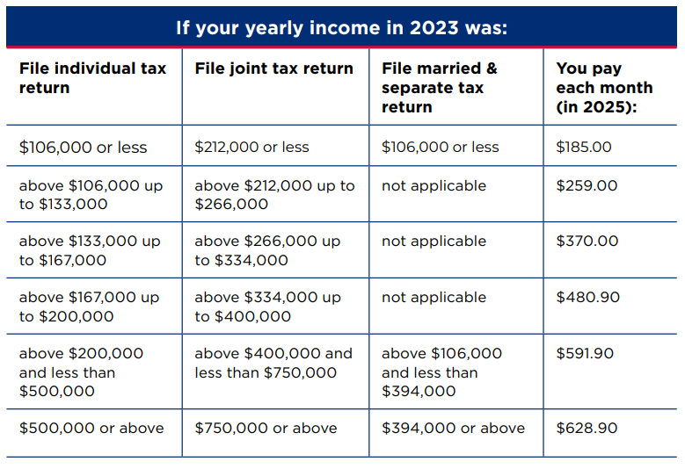
Medicare Part B - IRMAA
IRMAA brackets for 2026 won’t be announced until November 2025**
Income reported to IRS for 2023 is basis for what you pay in 2025 for Part B premium:
Source: https://www.medicare.gov/publications/11579-medicare-costs.pdf
Notes:
Since 2007, people with Medicare with higher incomes have paid higher Medicare Part B monthly premiums. These income‐related monthly premium rates affect roughly 5% of people with Medicare.
This chart shows the total Medicare Part B premiums for people with higher income for 2021.

Slide 36

Medicare Part B – Preventive Services
“Welcome to Medicare” Visit
Annual Wellness Visit
Additional screenings/tests/ services
See handouts & review the preventive services chart in the Medicare & You handbook &
discuss your prevention plan with your doctor.
“An ounce of prevention is worth a pound of cure”
-Benjamin Franklin
Notes:
Medicare Part B covers a range of exams, tests, screenings, and some shots intended to prevent, find, or manage a medical problem.
A description of these preventive services covered by Part B can be found in your Medicare & You handbook.
(Use the Preventive Services Chart—available on the Medicare Outreach and Assistance page of the GWAAR website—as a quick reference handout for your attendees.)

Slide 37
Medicare Part B – Preventive Services
“Welcome to Medicare” Visit
Preventive Service
Covered once within the first 12 months you have Part B
Includes:
Height, weight, and blood pressure
Body mass index
Vision test
Review of potential risk for depression and level of safety
Discussion about advance directives if you choose
A written plan regarding screenings, shots, and other preventive services needed
Note: This is NOT a physical!
Part B
Medical Insurance
Notes:
A “Welcome to Medicare” Visit is available within the first 12 months that you have Part B. It is NOT a physical. Important to ask for the Welcome to Medicare visit by name. This visit includes a review of your medical and social history related to your health and education and counseling about preventive services, including certain screenings, shots, and referrals for other care, if needed. The items listed will be covered during your “Welcome to Medicare” Visit.
The visit is covered by Medicare, including the deductible and co-payment. However, if you receive additional tests, labs or services the usual deductible and co-payments amounts will apply. Many of the preventive screenings and exams are also covered in full by Medicare, but some of them do require the Part B deductible and 20% co-payments

Slide 38
Medicare Part B – Preventive Services
Yearly “Wellness” Visit
Preventive Service
Includes:
Review of medical and family history
Develop list of current providers and prescriptions
Record height, weight, blood pressure
Create list of risk factors and treatment options
Detection of cognitive impairment
Establish schedule of screenings for appropriate preventive services
Offer personalized health advice
Note: Also, NOT a physical. Be sure to ask for the Yearly Wellness Visit by name.
Part B
Medical Insurance
Notes:
The main focus of the Yearly Wellness Visit is to create and update a prevention plan based on your current health and risk factors. You will be asked to complete a “Health Risk Assessment” to help your provider create a personalized prevention plan.
The visit is covered by Medicare once every 12 months at no charge, including the deductible and co-payment. However, if you receive additional tests, labs or services the usual deductible and co-payments amounts will apply.
Yearly Wellness Visit is NOT a physical. You should ask for the yearly wellness visit by name. Medicare does not cover a physical. If you schedule a physical, you may need to pay the full cost for the physical.
Many of the preventive screenings and exams are also covered in full by Medicare, but some of them do require the Part B deductible and 20% co-payments.

Slide 39

Check Your Knowledge – Question #5
For Original Medicare Part B, in most cases, you pay ______.
A monthly premium
A yearly deductible
20% coinsurance for most covered services
All of the above
Notes:
For Medicare Part B in most cases, you pay…
d. All of the above: a monthly premium, a yearly deductible, and 20% coinsurance for most covered services.

Slide 40
Medicare Supplement (Medigap) Insurance
Notes:
With ORIGINAL Medicare, you can add Medicare Supplement Insurance, known commonly as Medigap Insurance, to help fill in some of the gaps.

Slide 41
Medicare Supplement (Medigap) Insurance
Private insurance to supplement costs with Original Medicare A & B. Policies are approved and regulated by each state, here it is the WI Office of the Commissioner of Insurance (OCI)
You must have Medicare Parts A and B to buy
You pay a monthly premium
Costs vary depending on insurance company, optional benefits selected, age and sex of applicant, where applicant lives, etc.
Need to enroll in creditable drug coverage separately
No need to review coverage annually
Notes:
A Medicare Supplement Insurance policy (often called Medigap) is private health insurance that’s designed to supplement Original Medicare. This means it helps pay some of the health care costs that Original Medicare doesn’t cover (like copayments, coinsurance, and deductibles). If you have Original Medicare and a Medigap policy, Medicare will pay its share of the Medicare-approved amounts for covered health care costs. Then your Medigap policy pays its share.
You must have Part A and Part B to buy a Medigap policy.
Medigap policies cover only one person. If you and your spouse both want Medigap coverage, you’ll need to have separate Medigap policies.
You still pay the monthly Part B premium.

Slide 42
Medicare Supplement - Coverage
Basic Benefits: Covers 20% after Part B, copays for Part A, additional inpatient psychiatric days, first 3 pints of blood, 40 home care visits
Wisconsin Mandated Benefits: Covers some chiropractic services, 30 days non-Medicare Skilled Nursing Facility (Only applies to policies issued in Wisconsin to Wisconsin residents)
For more information, see OCI Publication titled
“WI Guide to Health Insurance for People with Medicare”
Notes:
Basic Benefits: 20% approved amount after Medicare on most services, co-
payments for Hospitalization and skilled nursing care, additional Psychiatric
care (175 days lifetime), First 3 pints blood, 40 additional Home Health care
visits.
WI Mandated: Usual/Customary cost of non-Medicare covered Chiropractic
care, 30 days non-Medicare skilled nursing facility care w/ no prior
hospitalization required (pays up to states Medicaid rate)
(note: some policies prior to 1/1/06 may still include diabetic mandate if the policy holder never took part D)
The Wisconsin mandated benefits apply to policies that were issued in the state of Wisconsin only.

Slide 43
Medicare Supplement - Coverage
Optional Riders (for additional premium cost):
Part A Deductible (or Part A 50% Deductible)
Part B Deductible (only available if eligible for Medicare prior to 1/2020)
Part B Copay/Coinsurance (reduces premiums)
Part B Excess Charges
Additional Home Health
Emergency Foreign Travel
Deductible Discount Rider
Note: Some plans offer a Deductible Discount Rider. In exchange for a lower policy premium, an annual deductible is in place that will end after a defined period of time.
Notes:
It is important to decide which extra benefits or “Optional Riders” you may be interested in purchasing with your Medigap policy.

Slide 44
Medicare Supplement – Types of Policies
“Traditional” Medicare Supplement
Beneficiary can receive services from any provider who accepts Medicare
Medicare Select policy
Beneficiary needs to obtain services through providers contracted w/the insurance company or HMO, except in emergencies
High-Deductible Medicare Supplement
Beneficiary is responsible for paying a deductible each calendar year; once the deductible is met, the policy pays costs after Medicare; deductible is adjusted annually
Notes:
There are different types of Medigap Policies.
See OCI Publication: “WI Guide to Health Insurance for People with Medicare” for more details.

Slide 45
Medicare Supplement – Types of Policies
Medicare Supplement/Select Cost-Sharing policy
After Medicare pays their portion for covered services, beneficiary pays 20% or 50% cost-sharing on the remaining balance
Once they have met their annual out-of-pocket maximum, the policy will cover the remainder of costs after Medicare
Medicare Cost policy (offered by certain HMOs approved by CMS)
HMO pays costs if beneficiary uses contracted providers. If beneficiary goes out of the HMO network, beneficiary pays Medicare deductibles, coinsurance, and copays out-of-pocket
Notes:
There are different types of Medigap Policies.
See OCI Publication: “WI Guide to Health Insurance for People with Medicare” for more details.

Slide 46
Medicare Supplement –Premium Types
Attained Age
Along with medical inflation and increased Medicare costs, the policy premium will also increase as you age. Premiums may be less expensive than issue age policies when you first purchase, but more expensive over time
Issue Age
Premiums are set at your age when you buy the policy and will not increase because you get older; premiums may increase for other reasons, including medical inflation and increased Medicare costs
No Age Rating
Premium is the same for all policy holders, regardless of age
Under Age 65
Premium is calculated for a person eligible for Medicare due to a disability
Notes:
There are different types of Medigap Policies.
See OCI Publication: “WI Guide to Health Insurance for People with Medicare” for more details.

Slide 47
Medicare Supplement – Steps to Buying
STEP 1: Decide which benefits (riders) you want, then decide which of the Medigap policies meets your needs.
STEP 2: Find out which insurance companies sell Medigap policies in your state.
STEP 3: Call the insurance companies (or insurance agent) that sell the Medigap policies you’re interested in and compare costs.
STEP 4: Buy the Medigap policy.
Notes:
Here are the steps to take if you are interested in buying a Medigap policy:
STEP 1: Decide which benefits (Riders) you want, then decide which of the Medigap policies meets your needs.
STEP 2: Find out which insurance companies sell Medigap policies in your state.
STEP 3: Call the insurance companies that sell the Medigap policies you’re interested in and compare costs.
STEP 4: Buy the Medigap policy.

Slide 48
Medicare Supplement – Open Enrollment Period (OEP)
Lasts 6-months, beginning the first month you are 65 or older and enrolled in Part B. This is the best time to purchase a policy as you cannot be denied or charged more based on your health history
If you delay enrolling in Medicare Part B because you or your spouse are still working and you have group health coverage as primary (clarify with employer how their insurance coordinates with Medicare), your Medigap OEP is delayed until you are enrolled in Part B
If you have Medicare due to a disability, you qualify for a 2nd Medigap OEP - begins the month you turn 65
You can purchase a Medicare supplement any time an insurance company will sell you one, however, companies can charge you higher premiums or deny you coverage outside of your OEP
Notes:
The best time to buy a Medigap policy is during your Medigap Open Enrollment Period (Medigap OEP). This period lasts for 6 months and begins on the first day of the month in which you’re both 65 or older and enrolled in Medicare Part B. If you apply during your Medigap OEP, you can buy any Medigap policy the company sells, even if you have health problems, for the same price as people with good health. If you don’t purchase a plan within your 6-month OEP, insurance companies can deny coverage based on your health condition.
It’s also important to understand that your Medigap rights may depend on when you choose to enroll in Medicare Part B. If you’re 65 or older, your Medigap OEP begins when you enroll in Part B, and it can’t be changed or repeated. In most cases, it makes sense to enroll in Part B and purchase a Medigap policy when you’re first eligible for Medicare, because you might otherwise have to pay a Part B late enrollment penalty, and you might miss your Medigap OEP. However, there are exceptions if you have employer coverage.
While the insurance company can’t make you wait for your coverage to start, it may be able to make you wait for coverage related to a pre-existing condition. Remember, for Medicare‑covered services, Original Medicare will still cover the condition, even if the Medigap policy won’t cover your out‑of‑pocket expenses.
You may buy a Medigap policy any time an insurance company will sell you one.

Slide 49
Medicare Supplement – Open Enrollment Period (OEP)
During Your Medigap OEP | NOT During Your Medigap OEP
Best time to buy | May have waiting period for preexisting conditions
Guaranteed Issue Period | May cost more
Companies must sell to you any policy they sell for the same price even if you have a pre-existing condition | Companies can deny coverage
Notes:
The best time to buy a Medigap policy is during your Medigap Open Enrollment Period (Medigap OEP). This period lasts for 6 months and begins on the first day of the month in which you’re both 65 or older and enrolled in Medicare Part B. If you apply during your Medigap OEP, you can buy any Medigap policy the company sells, even if you have health problems, for the same price as people with good health. If you don’t purchase a plan within your 6-month OEP, insurance companies can deny coverage based on your health condition.
It’s also important to understand that your Medigap rights may depend on when you choose to enroll in Medicare Part B. If you’re 65 or older, your Medigap OEP begins when you enroll in Part B, and it can’t be changed or repeated. In most cases, it makes sense to enroll in Part B and purchase a Medigap policy when you’re first eligible for Medicare, because you might otherwise have to pay a Part B late enrollment penalty, and you might miss your Medigap OEP. However, there are exceptions if you have employer coverage.
While the insurance company can’t make you wait for your coverage to start, it may be able to make you wait for coverage related to a pre-existing condition. Remember, for Medicare‑covered services, Original Medicare will still cover the condition, even if the Medigap policy won’t cover your out‑of‑pocket expenses.
You may buy a Medigap policy any time an insurance company will sell you one.

Slide 50
Medicare Supplement – Guaranteed Issue Rights
Other times you cannot be denied a policy:
Your Medicare Advantage or Medicare Cost plan terminates or stops providing care in your service area
You move outside the plan’s geographic service area
You leave a health plan because it failed to meet its contract obligations to you
Your employer group health plan ends some or all of your coverage
Your employer group plan increases cost by more that 25% in one 12 month period
You are in your “Trial Period” with a Medicare Advantage plan or Medicare cost plan and want to purchase a Medigap policy or go back to the policy you had previously
Other specific circumstances
Must apply for Medicare Supplement within 63 days of the date your other coverage ends or you receive notice your group policy is going to end, whichever is later.
Notes:
These are other times that you can receive Guarantee Issue for a Medigap policy:
Your Medicare Advantage plan terminates or stops providing care in your service area.
You move outside the plan’s service area.
Your employer group health plan ends some or all of your coverage. (But if employee voluntarily leaves the plan or ends his/her own coverage, you will NOT have guarantee issue.)
Your employer group plan increases cost by more that 25% in one 12 month period.
You are in Trial Period of Medicare Advantage plan. (12 month period the first time you join a MA plan. You get only 1 trial period in a lifetime.)
Remember, you must apply within 63 days of other coverage ending.

Slide 51
Medicare Supplement - Resources
Questions and/or assistance:
WI SHIP - Medigap Helpline 1-800-242-1060 https://longtermcare.wi.gov/Pages/Medigap.aspx
WI Commissioner of Insurance 1-800-236-8517
https://oci.wi.gov
Medicare 1-800-MEDICARE
www.Medicare.gov
Notes:
Here are some resources that can be of help to you with any questions or for more information about Medigap policies.

Slide 52
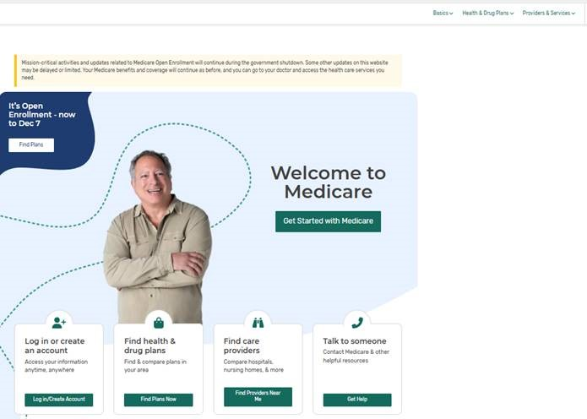
Medicare Supplement - Plan Finder Tool
www.medicare.gov
Go to:
Notes:
Another way to navigate to Medicare Supplement Plan information on the Medicare.gov site

Slide 53

Check Your Knowledge – Question #6
Medigap (Medicare supplement insurance) policies may help fill in which coverage or cost gaps?
a. Part A and/or Part B deductibles
b. Medicare enrollment penalties
c. Prescription Drug Copays
d. Medicare Premiums
Notes:
Check Your Knowledge—Question 9
Medigap (Medicare supplement insurance) policies may help fill which coverage or cost gaps?
a. Part A and/or Part B deductibles
b. Medicare Enrollment Penalties
c. Prescription Drug Copays
d. Medicare Premiums
Answer: a. Part A and/or Part B deductibles
Medicare supplement insurance policies (Medigap) covers gaps in Original Medicare coverage, like deductibles, coinsurance, and copayments for Medicare covered services.

Slide 54

Medicare Part D
Part D
Medicare prescription drug coverage
Notes:
Medicare Part D is Medicare prescription drug coverage.
If you chose Original Medicare and you want prescription drug coverage, you must choose and join a Medicare Prescription Drug Plan. You usually pay a monthly premium.
These plans are run by private companies that contract with Medicare.
Part D coverage is provided through Medicare Prescription Drug Plans (PDPs) and Medicare Advantage (Part C) Plans with Medicare prescription drug coverage.
You can enroll online at www.medicare.gov, (we’ll talk more about that shortly), or you may call Medicare to enroll at 1-800-633-4227 or contact the plan directly. You can find the plan contact information on the Plan Finder.

Slide 55
Medicare Part D
Covers FDA-approved prescription drugs
You need to be enrolled in Medicare Part A and/or Part B
To receive Part D coverage, you must enroll in a Part D Plan
Run by private companies contracted with Medicare
Part D Plans are provided through:
Stand alone Medicare Prescription Drug Plans (PDPs) that work with Original Medicare
Medicare Advantage Prescription Drug Plans (MA-PDPs)
Part D
Medicare prescription drug coverage
Compare plans and enroll using the
Plan Finder Tool: www.medicare.gov
Notes:
Medicare Part D is Medicare prescription drug coverage.
If you chose Original Medicare and you want prescription drug coverage, you must choose and join a Medicare Prescription Drug Plan. You usually pay a monthly premium.
These plans are run by private companies that contract with Medicare.
Part D coverage is provided through Medicare Prescription Drug Plans (PDPs) and Medicare Advantage (Part C) Plans with Medicare prescription drug coverage.
You can enroll online at www.medicare.gov, (we’ll talk more about that shortly), or you may call Medicare to enroll at 1-800-633-4227 or contact the plan directly. You can find the plan contact information on the Plan Finder.

Slide 56
Medicare Part D - Coverage
What IS Covered:
What is NOT Covered:
Prescribed medications
Medications that are included in a plan’s formulary (Not all medications are covered by all plans.)
The law excludes certain medications from coverage under Part D.
Medications must be for medically prescribed use and FDA approved.
Insulin and needles and syringes for the administration of insulin
Medications that are not on a plan’s formulary are usually not covered.
Non-prescription, over-the-counter drugs
Drugs that are not approved by the Federal Drug Administration (FDA)
Vitamins and minerals
Cough medicine
ED medications
Drugs for cosmetic purposes
Weight loss or weight gain
Hair loss
Part D
Medicare prescription drug coverage
Notes:
Medicare Part D plans cover:
Prescribed medications.
Medications that are included in a plan’s formulary. Not all medications are covered by all plans.
The law excludes certain medications from coverage under Part D.
Medications must be for medically prescribed use.
Insulin and needles and syringes for the administration of insulin.

Slide 57
Medicare Part D – Enrollment
Initial Enrollment Period (IEP)
3 months prior, month of, and 3 months after starting Medicare
Annual Open Enrollment Period
October 15 - December 7, for coverage starting January 1st of the following year
Medicare Advantage Open Enrollment Period
January 1 – March 31, only for people already enrolled in an Advantage plan
Special Enrollment Period (SEP)
Under certain circumstances, you may be able to change your Medicare prescription drug coverage outside of your IEP and the Annual Open Enrollment Period. Examples: moving out of your plan’s service area, loss of Medicaid, Medicare ends your plan’s coverage, etc.
Part D
Medicare prescription drug coverage
IMPORTANT: Review your plan coverage every year!
Notes:
These are the times that you can enroll in a Part D plan:
Initial Enrollment Period
3 months prior, month of, and 3 months after starting Medicare.
Annual Open Enrollment Period
Enroll October 15 thru December 7th each year for coverage starting January 1st of the following year.
Medicare Advantage Open Enrollment Period—Only for people already enrolled in a MA plan.
Special Enrollment Period
Life events that allow an SEP include, but aren’t limited to, if you
Permanently move out of your plan’s service area
Lose other creditable prescription coverage
Weren’t properly told that your other coverage wasn’t creditable, or your other coverage was reduced and is no longer creditable
Enter, live at, or leave a long-term care facility
Have a continuous SEP if you qualify for Extra Help
Belong to a State Pharmaceutical Assistance Program
Join or switch to a plan that has a 5-star rating
Have other exceptional circumstances
Most SEPs last 2 months

Slide 58
Medicare Part D – 2026 Costs
Premiums, Deductibles, and Copays or Coinsurance
Costs vary by plan and change annually
2026 premiums: $0 to $116/month estimate
2026 national base beneficiary premium: $38.99
2026 deductible: $615 max or less
2026 OOP Max: $2,100
Copays and coinsurance may vary per plan, per drug, per pharmacy
Income-Related Monthly Adjustment Amount (IRMAA)
People with Part D and higher incomes, about 5% of beneficiaries, pay an additional amount on top of their premium called an IRMAA
Part D
Medicare prescription drug coverage
Notes:
Here are the 2022 costs related to Part D.
Your costs for prescription drug coverage will depend on the plan you choose and some other factors, like which drugs you use, whether you go to a pharmacy in your plan’s network, and whether you get Extra Help paying for your drug costs.

Slide 59
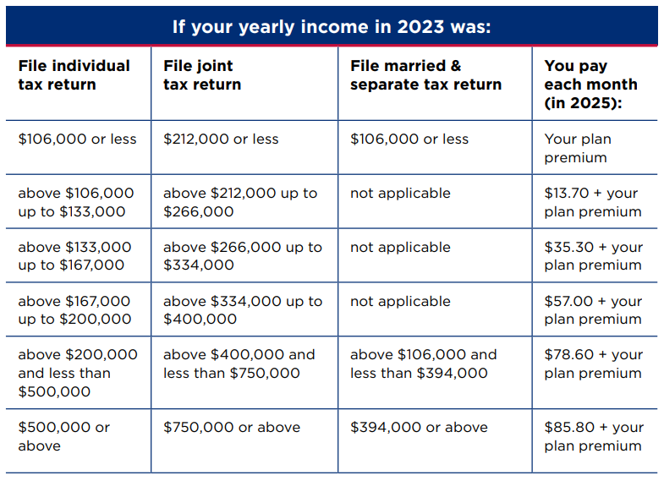
Medicare Part D – 2025 IRMAA
IRMAA brackets for 2026 won’t be announced until November 2025**
Income reported to IRS for 2023 is basis for what you pay in 2025 for Part D premium:

Slide 60
Medicare Part D – Costs
Late Enrollment Penalty (LEP)
You may pay an LEP if you did not enroll in Part D during the IEP and did not have other creditable drug coverage
The penalty is 1% of the average national monthly premium ($38.99 in 2026) for every month you delayed enrollment
The penalty will be added to your monthly premium if and when you enroll in a Part D plan, and it will continue as long as you are enrolled
Creditable Coverage
Other prescription drug coverage that is expected to pay, on average, at least as much as Medicare’s standard Part D coverage, such as:
Veterans Administration (VA) drug coverage
Wisconsin SeniorCare Program
Some types of Employer Coverage (must ask)
Part D
Medicare prescription drug coverage

Slide 61
Medicare Part D – 2026 Standard Benefit Structure
Effective January 1, 2026
Deductible Phase | Initial Coverage Phase | Catastrophic Phase
Standard maximum annual deductible of up to $615 Enrollee pays 100% of Rx costs | Enrollee pays up to 25% of coinsurance Out of pocket limit of $2100 applies (includes deductible) | Beneficiary pays 0% coinsurance No costs for covered drugs
Starts over after December 31 every year
Notes:
This graphic sums up the Medicare Part D costs for 2024.
If your plan has a deductible, it cannot be more than $545. You will pay the full cost for your medications until you reach your deductible.
During your initial coverage period, you will pay a either a copay or a coinsurance amount for your medications, which will be no more than 25% of the cost of the drug. Some plans may have low cost generic drugs with very low copays during this initial coverage period, from $0 and up.

Slide 62
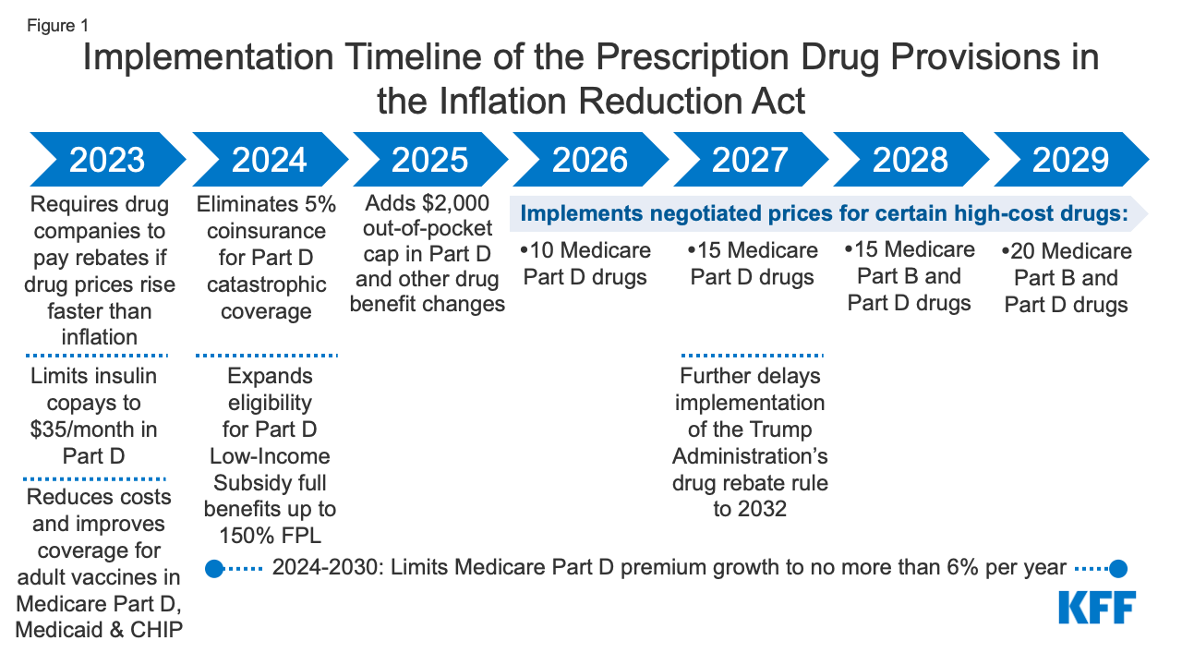
Inflation Reduction Act – Prescription Drug Provisions
Source: www.kff.org

Slide 63
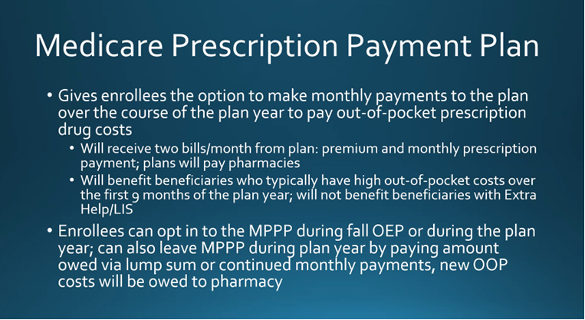
Medicare Part D – New in 2025: MPPP
Notes:
Here are some resources that can be of help to you with any questions or for more information about Medigap policies.

Slide 64
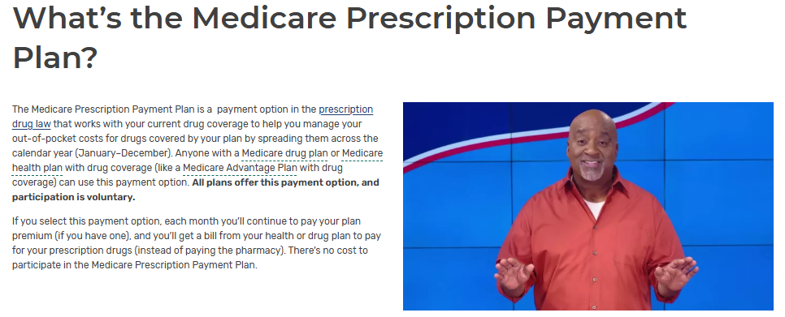
Medicare Part D – New since 2025: MPPP
https://www.medicare.gov/prescription-payment-plan
Notes:
Here are some resources that can be of help to you with any questions or for more information about Medigap policies.

Slide 65
Medicare Part D - Resources
Questions and/or assistance:
WI SHIP - Medigap Part D & Prescription Drug Helpline
1-855-677-2783; BOALTCRXHelpline@wisconsin.gov
https://longtermcare.wi.gov/Pages/Medigap.aspx
Local Senior Focal Point – Case Management Program
Call ADRC (608-240-7400) for contact information
Medicare
1-800-MEDICARE; www.Medicare.gov
Notes:
Here are some resources that can be of help to you with any questions or for more information about Medigap policies.

Slide 66
Medicare Part D - Plan Finder Tool
Compare plans at
www.medicare.gov
Notes:
Another way to navigate to Medicare Supplement Plan information on the Medicare.gov site

Slide 67

Check Your Knowledge – Question #7
It’s July. You enrolled in Medicare last year but didn’t enroll in a Medicare drug plan. Generally, when is your next chance to enroll in Part D?
Annual Open Enrollment Period
Initial Enrollment Period
Your next birthday
12 months after your initial enrollment
Notes:
Check Your Knowledge–Question 5
It’s July. You enrolled in Medicare last year, but didn’t enroll in a Medicare drug plan. Generally, when is your next chance to enroll in Part D?
Answer: a. Annual Open Enrollment Period (October 15-December 7, annually)

Slide 68

Medicare Advantage Plans (Part C)

Slide 69



Medicare Advantage Plans (Part C)
Part C Includes
Medicare Advantage plans, sometimes called Part C, include Part A and Part B benefits, and usually Part D
Private insurance companies approved by Medicare provide your Medicare coverage
Most plans are HMOs or PPOs with provider networks. You must use plan doctors, hospitals, and other providers, or you will pay more or all of the costs
Part A
Hospital Insurance
Part B
Medical Insurance
Most include Part D
Medicare prescription drug coverage
Notes:
Medicare Advantage Plans (Part C), like a Health Maintenance Organization (HMO) or a Preferred Provider Organization (PPO), cover Part A and Part B services and supplies. They also may include Medicare prescription drug coverage (MA-PD). You can add a Part D plan to a Medicare Private Fee-for-Service, or Medicare Medical Savings Account (MSA) Plan that doesn’t have prescription drug coverage included. You can't add Part D coverage to an HMO or PPO plan without drug coverage.

Slide 70
Medicare Advantage Plans - Costs
Part C Includes
What you Pay:
Part B monthly premium ($185 for most in 2025)
Additional monthly premium to the Advantage plan company - depends on the plan
Some plans have $0 premium
Deductibles, coinsurance, and copayments
Different from Original Medicare
Vary from plan to plan
May be higher if using out-of-network providers
Part A
Hospital Insurance
Part B
Medical Insurance
Most include Part D
Medicare prescription drug coverage
Notes:
If you join a Medicare Advantage Plan, you must continue to pay the standard monthly Medicare Part B premium. The Part B premium in 2022 is $170.10.
A few plans may pay all or part of the Part B premium for you.
Some people may be eligible for assistance with Medicare costs. (Medicare Savings Programs and Extra Help for people with Medicare who have limited income and resources). This will be discussed later in the presentation.
When you join a Medicare Advantage Plan there are other costs you may have to pay, such as
An additional monthly premium to the plan
Deductibles, coinsurance, and copayments
These costs may
Be different from Original Medicare
Vary from plan to plan
Be higher if you go out of network
The out-of-pocket maximum this year is $6,700 for an individual
Part C Plans have a yearly limit on your out-of-pocket costs for medical services. Once you reach this limit, you’ll pay nothing for covered services. This limit may be different between Part C Plans and can change each year. You should consider this when choosing a plan.

Slide 71
Medicare Advantage Plans - Coverage
If you join a Medicare Advantage Plan you:
Still get all services covered by Part A and Part B, but you get them through the Medicare Advantage Plan
May choose a plan that includes Part D prescription drug coverage.
May have different benefits and cost-sharing
Can’t be charged more for certain services than you would pay under Original Medicare
May have a yearly limit on your out-of-pocket costs for medical services.
Once you reach this limit, you’ll pay nothing for covered services
May choose a plan that includes extra benefits not covered by Original Medicare, such as vision or dental care
Cannot use a Medigap policy to supplement your coverage
Part C Includes
Part A
Hospital Insurance
Part B
Medical Insurance
Most include Part D
Medicare prescription drug coverage
Notes:
If you join a Medicare Advantage Plan, you
Are still in Medicare with all rights and protections
Still get those services covered by Part A and Part B, but the Part C Plan covers those services instead (must have both Part A and Part B to join a Part C Plan)
May choose a plan that includes prescription drug coverage
Benefits and cost-sharing may be different
May choose a plan that includes extra benefits such as vision or dental offered at the plan’s expense (not covered by Medicare)
Part C Plans can't charge more than Original Medicare for certain services like chemotherapy, dialysis, and skilled nursing facility care
Part C Plans have a yearly limit on your out-of-pocket costs for medical services. Once you reach this limit, you’ll pay nothing for covered services. This limit may be different between Part C Plans and can change each year. You should consider this when choosing a plan.
You can’t use a Medigap policy with a Part C Plan.

Slide 72
Medicare Advantage Plans - Considerations
PROS: CONS:
+ Coordinated care with network physicians
+ Some offer extra benefits (vision, dental, hearing)
+ May have lower monthly premium (in addition to the Part B premium)
+ Must follow CMS regulations
+ Out-of-pocket copay maximum
+ Varied plans and choices
+ Can change plans each year
- Must re-evaluate plan each year/May need to change plans
- Enrollment is limited to specific times of the year
- May have higher out of pocket expenses
- No State mandates or protections for extras
- Higher costs when out of network
- Confusion over plans/coverage

Slide 73
Medicare Advantage – Enrollment
Initial Enrollment Period (IEP)
3 months prior, month of, and 3 months after starting Medicare
Annual Open Enrollment Period
October 15 - December 7, for coverage starting January 1st of the following year
Medicare Advantage Open Enrollment Period
January 1 – March 31, only for people already enrolled in an Advantage plan.
Special Enrollment Periods (SEPs)
Under certain circumstances, you may be able to change your Medicare Advantage plan coverage outside of your IEP and the annual enrollment periods. Examples: moving out of your plan’s service area, loss of Medicaid, etc.
Part D
Medicare prescription drug coverage
IMPORTANT: Review your plan coverage every year!
Notes:
These are the times that you can enroll in a Part D plan:
Initial Enrollment Period
3 months prior, month of, and 3 months after starting Medicare.
Annual Open Enrollment Period
Enroll October 15 thru December 7th each year for coverage starting January 1st of the following year.
Medicare Advantage Open Enrollment Period—Only for people already enrolled in a MA plan.
Special Enrollment Period
Life events that allow an SEP include, but aren’t limited to, if you
Permanently move out of your plan’s service area
Lose other creditable prescription coverage
Weren’t properly told that your other coverage wasn’t creditable, or your other coverage was reduced and is no longer creditable
Enter, live at, or leave a long-term care facility
Have a continuous SEP if you qualify for Extra Help
Belong to a State Pharmaceutical Assistance Program
Join or switch to a plan that has a 5-star rating
Have other exceptional circumstances
Most SEPs last 2 months

Slide 74
Medicare Advantage - Resources
Questions and/or assistance:
WI SHIP - Medigap Helpline 1-800-242-1060 https://longtermcare.wi.gov/Pages/Medigap.aspx
WI Commissioner of Insurance 1-800-236-8517 https://oci.wi.gov
Medicare 1-800-MEDICARE www.Medicare.gov
Local Senior Focal Point – Case Management Program
Call ADRC (608-240-7400) for contact info.
Notes:
Here are some resources that can be of help to you with any questions or for more information about Medigap policies.

Slide 75
Medicare Advantage - Plan Finder Tool
Compare plans at
www.medicare.gov
Notes:
Another way to navigate to Medicare Supplement Plan information on the Medicare.gov site

Slide 76

Check Your Knowledge – Question #8
In most cases, you can get Medicare prescription drug coverage at the pharmacy through _____.
Part A and Part B
Part B and Part C
Part C and Part D
All of the above
Notes:
Check Your Knowledge–Question 7
In most cases, you can get Medicare prescription drug coverage through______.
Answer: c. Part C & D

Slide 77

Check Your Knowledge – Question #9
Medicare Advantage Plans __________.
Help pay for gaps in Original Medicare
Cover less services than Original Medicare
Are private plans approved by each state
Notes:
Check Your Knowledge—Question 8
Medicare Advantage Plans__________.
Answer: a. Help pay for gaps in Original Medicare

Slide 78

Medicare & The Health Insurance Marketplace
Medicare isn’t part of the Marketplace
If you have Medicare, you’re covered and don’t need to do anything related to the Marketplace
Marketplace doesn’t offer Medigap or Part D prescription drug plans
It’s against the law for someone who knows you have Medicare to sell you a Marketplace plan, even if you only have Part A or Part B
New in 2026: Open Enrollment shortened to: 11/1/2026-12/15/2026
For more information:

Slide 79
Keeping a Marketplace Plan with Premium Tax Credit Instead of Having Medicare
There are some situations where you can keep your Marketplace plan with premium tax credit:
If you’re eligible for Medicare but haven’t enrolled in it because:
You would have to pay a premium for Part A
You have a medical condition that qualifies you for Medicare, like ESRD, but haven’t applied for Medicare coverage
You’re enrolled in Medicare and you’re paying a premium for Part A
You can drop your Part A and Part B coverage and get a Marketplace plan instead
You are in your 24-month disability waiting period and not eligible for Medicare yet
*Adapted from CMS publication

Slide 80
Marketplace – Considerations
In most cases, Medicare will cost less than a Marketplace plan without premium tax credits (PTCs)
You may have to pay back all or some of the PTCs you received for months you were enrolled in both Marketplace coverage w/ PTCs and premium-free Part A
Marketplace plans may not pay claims that would be covered by Part B, if you’re eligible for Part B but didn’t sign up
If you decide to end your Medicare and it’s ended retroactively, you’ll have to pay back any claims that Medicare paid during that time
The Inflation Reduction Act delayed the expiration of PTCs until the end of 2025 – if Congress does not act, Marketplace premiums will increase an average of 75% - we are awaiting these changes!
If you delay signing up for Medicare and decide to sign up later, you’ll likely:
Need to sign up during the GEP or SEP, if you qualify
Be responsible for a lifetime Medicare Part B late enrollment penalty
*Adapted from CMS publication

Slide 81

Check Your Knowledge – Question #10
It’s against the law for someone to sell you a Marketplace plan if they know you have Medicare.
True
False
Notes:
Check Your Knowledge—Question 10
It’s against the law for someone to sell you a Marketplace plan if they know you have Medicare.
Answer: a. True

Slide 82
Other Types of Health Insurance
Employer/Retiree Group Health Plan
Is it a Supplement or Medicare Advantage plan?
Some offer creditable prescription drug coverage
Contact your employer or union benefits administrator to find out how your insurance works with Medicare.
Military Coverage: TriCare for Life and CHAMPVA
Medical Assistance/Low Income Programs
Notes:
Here are some other ways that people may receive coverage for their healthcare.

Slide 83

Help for People with Limited Income & Resources
Medicaid (aka Medical Assistance or Title 19)
Needs-based Federal-State health insurance program
Medicare Savings Programs (MSPs)
If eligible, your Medicare Part B premium will be paid for you by State of WI.
Some also have Medicare copays and deductibles paid as well, based on income and assets.
Extra Help (Low Income Subsidy)
Assistance with Medicare prescription drug coverage.
Reduces Part D premiums, deductibles, and copays based on income and assets.
SeniorCare
State Pharmaceutical Assistance Program in Wisconsin for residents age 65+
Level of assistance depends on annual income.
Notes:
Many people with Medicare face challenges when it comes to paying for health care and prescription medications. In fact we often hear of people who have to choose between paying for groceries or paying for healthcare or medicine. Here are some programs that can help:
Medicare Savings Plans
If eligible, your Medicare Part B premium will be paid for you.
Some also have Medicare copays and deductibles paid as well based on income & assets.
Extra Help (Low Income Subsidy)
Assistance with Medicare prescription drug coverage.
Reduces Part D premiums, deductibles and copays based on income & assets.
Senior Care
Level of assistance depends on annual income.

Slide 84
Help for People with Limited Income & Resources
Program Eligibility Guidelines – 2025 (based on FPL set in January)
Program | Single Individual (Unmarried) |  | Married Couple
 | Income | Assets | Income | Assets
Medicare Savings Program | <$1,760.63/ month | < $9,660 | < $2,379.38/ month | < $14,470
Extra Help (“Low Income Subsidy”) | <$1,956.26/ month | < $17,600 | < $2,643.75/ month | < $35,130
Wisconsin SeniorCare Level 1 | <$25,040/year | No asset limit | < $33,840/year | No asset limit
Notes:
This chart shows the eligibility guidelines for the benefit programs. Although there are different levels for each of these programs, the chart shows the highest income and asset limits to be eligible for the programs.
Even if a person doesn’t meet these limits, they are encouraged to fill out an application or contact us for assistance if they struggle with paying healthcare or prescription costs. These income limits change yearly and people may be eligible for other savings programs depending on their situation.

Slide 85
Medicare Savings Programs - Income & Resource limits
Program Eligibility Guidelines – 2025 (based on FPL set in Jan.)
Medicare Savings Program | Individual Monthly Income Limit* | Married Couple Monthly Income Limit* | Helps Pay Your
Qualified Medicare Beneficiary (QMB) | $1,304.17 | $1,762.50 | Part A and Part B premiums, and other cost-sharing (like deductibles, coinsurance, and copayments)
Specified Low-Income Medicare Beneficiary (SLMB) | $1,565.00 | $2,115.00 | Part B premiums only
Specified Low-Income Medicare Beneficiary Plus (SLMB+; QI-1) | $1,760.63 | $2,379.38 | Part B premiums only
Asset limit for all MSPs is $9,660 for an individual and $14,470 for a couple (2025)
For more information: https://www.dhs.wisconsin.gov/publications/p1/p10062.pdf

Slide 86

SeniorCare
Wisconsin’s State Prescription Assistance Program
Offers coverage for prescription drugs and vaccines that protect against shingles, tdap (tetanus, diphtheria, pertusis), meningitis, Hepatitis A & B, COVID-19, Flu, and pneumonia
Available to Wisconsin residents age 65+ who are U.S. citizens or have qualifying immigrant status
Creditable coverage to Medicare Part D. May use alone or in addition to Medicare Part D
$30 annual application fee, per person
Can enroll anytime during the year
No monthly premium; no asset limit
Your annual income determines your out of pocket costs
For more information or to access an application online: www.dhs.Wisconsin.gov/seniorcare
Or call:
1-800-657-2038
Notes:
For additional assistance with prescription drug coverage, you may want to consider Wisconsin’s prescription drug assistance program, called SeniorCare.
This program is available to people of all income levels and the coverage level is determined by your income level. For additional information and/or for an application, contact SeniorCare online or by calling the phone number on this slide.

Slide 87
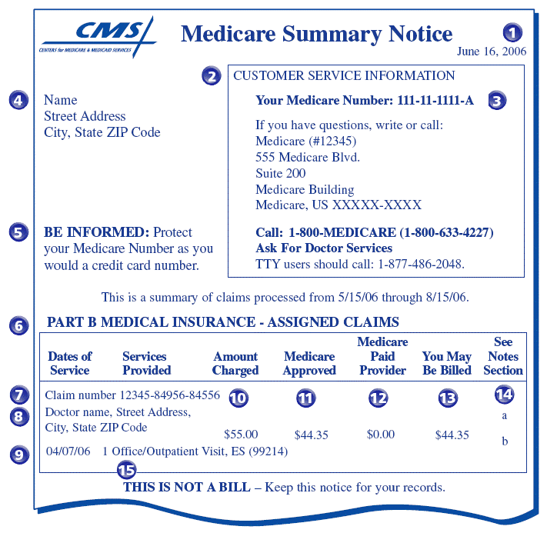
Words of Caution
Always review your Medicare Summary Notice!
This is not a bill.
It is sent quarterly.
Check name, address, Medicare number for accuracy.
Did you receive the service?
Be sure claim is processed and paid. If item is denied, call doctor’s office to make sure claim was coded properly. If not, office can resubmit.
If denied, you have appeal rights. Appeal deadline is 120 days.
Notes:
The Medicare Summary Notice (MSN) is sent quarterly to people with Medicare. If you have set up an account at MyMedicare.gov, you can use it to view your MSN as claims are processed rather than wait for it to be mailed.
It is important to review your MSN when you receive it.
It is not a bill.
Check name, address, Medicare number for accuracy.
Did you receive the service?
Be sure claim is processed and paid. If item is denied, call doctor’s office to make sure claim was coded properly. If not, office can re-submit.
If denied, you have appeal rights. Appeal deadline 120 days.
Report any fraud or abuse.

Slide 88

Words of Caution
Three Steps to Prevent Fraud
Step 1: Protect Yourself and Others from Medicare Fraud
DON’T
DO
Do treat your Medicare card and number like your credit card.
Do watch out for identity theft.
Do be aware that Medicare doesn’t call or visit to sell you anything.
Do be cautious of offers for “free” medical services.
Do pass it on!
Don't give out your Medicare number except to your doctor or other Medicare provider.
Notes:
The Wisconsin Senior Medicare Patrol has a few more words of caution.
There are three steps they suggest to prevent fraud:
Step 1: Protect Yourself and others from Medicare Fraud.

Slide 89
Words of Caution
Step 2: Detect Medicare Fraud & Abuse
Always review those Medicare Summary Notices (MSNs)!
Access your Medicare information online at www.Medicare.gov.
Create a Personal Health Care Journal:
Record doctor visits, tests and procedures in the journal and take it with you to appointments.
Compare your MSNs and other statements to your journal to make sure they are correct.
Notes:
Step 2: Detect Medicare Fraud by reviewing your Medicare Summary Notices and comparing them to your personal health care journal.

Slide 90
Words of Caution
Step 3: Report Suspected Medicare Fraud and Abuse
Call the provider
Gather information and documentation
Contact WI Senior Medicare Patrol (SMP)
https://www.smpwi.org/
1-888-818-2611 (Free and Confidential!)
To report suspected fraud/abuse
For training, speakers, and/or materials
To volunteer with the SMP program
Notes:
And Step 3: Report any suspected Medicare fraud.
Call the provider to discuss any concerns you have about a bill, etc.
Be sure to gather your documentation—personal healthcare journal/statements, etc.
Contact WI SMP for help!

Slide 91
Resources
Medicare
Medicare & You 2025: https://www.medicare.gov/Pubs/pdf/10050-Medicare-and-You.pdf
1-800-MEDICARE, TTY 1-877-486-2048; www.medicare.gov
Social Security Administration (SSA)
Local office: 1-866-770-2262; 6011 Odana Road, Madison, WI 53719
National: 1-800-772-1213; www.ssa.gov
Medigap Helpline – WI Board on Aging and Long Term Care
1-800-242-1060
https://longtermcare.wi.gov/Pages/Medigap/Medigap.aspx
Provides information and assistance related to Medicare supplements and Advantage plans, long-term care insurance, and more
Medigap Part D & Prescription Drug Helpline
1-855-677-2783
https://longtermcare.wi.gov/Pages/Medigap/Medigap.aspx
Provides information and assistance related to Part D Plans, Advantage Drug Plans and Pharmaceutical Assistance Programs
Notes:
I hope this information has been helpful as you consider your options for Medicare coverage. Here are some agencies that can help if you have questions or need additional information or assistance.

Slide 92
Resources
Wisconsin Office of the Commissioner of Insurance (OCI)
https://oci.wi.gov/Pages/Consumers/Medicare.aspx
OCI regulates the insurance industry in Wisconsin; OCI also publishes annual list of approved Medicare Supplement (Medigap) plans
State of Wisconsin Board on Aging and Long Term Care
http://longtermcare.wi.gov/
Wisconsin Medicaid for Elderly (age 65+), Blind, and Disabled
https://www.dhs.wisconsin.gov/medicaid/index.htm
Dane County Veterans Service Office (VSO)
(608) 266-4158
http://www.danevets.com/

Slide 93
Resources
Aging & Disability Resource Center (ADRC) of Dane County
Call (608) 240-7400 between 7:45am and 4:30pm, Monday - Friday, to speak to an Information & Assistance (I&A) Specialist
Walk-in assistance provided at the office: 2865 N Sherman Ave, Madison, WI 53704
Provides information and assistance to the public about programs and resources specific to adults with disabilities and older adults
https://www.daneadrc.org/
Dane County Senior Centers / Focal Points
12 Focal Points serving specific geographic areas across Dane County
To determine which Focal Point serves your location, contact the ADRC: 608-240-7400
Elder Benefit Specialist (EBS) Program - Area Agency on Aging (AAA) of Dane County
Call the ADRC to discuss a referral: 608-240-7400
Provides legal and advocacy-related services to Dane County residents age 60 and older experiencing problems/issues related to public or private benefits including Medicare, Social Security, and others
Notes:
Thank you for attending the Welcome to Medicare program today.

Slide 94

Please complete your evaluation form!
Your feedback is important to us and helps us plan for future trainings!

